Slide 1
Beer Case Study
Allen Ansari, Audrene Tiakor
DS 6306 Doing Data Science
2019

Slide 2
Agenda
Introduction
Data Description
EDA
Conclusion
Q&A

Slide 3
Introduction
Explanatory Data Analysis of Beer data
Regression Model
Analysis of Variance by Region

Slide 4
Data Description
Two data sets are available
Beers.csv
contains 2410 US craft beers
Breweries.csv
contains 558 US breweries

Slide 5
Data Parameters Description
Beers data set:
Name: Name of the beer.
Beer_ID: Unique identifier of the beer
ABV: Alcohol by volume of the beer
IBU: International Bitterness Units of the beer
Brewery_ID: Brewery id associated with the beer
Style: Style of the beer
Ounces: Ounces of beer

Slide 6
Data Parameters Description
Breweries Data Set:
Brew_ID: Unique identifier of the brewery
Name: Name of the brewery
City: City where the brewery is located
State: U.S. State where the brewery is located

Slide 7
Explanatory Data Analysis
Number of breweries in each state
AK | AL | AR | AZ | CA | CO | CT | DC | DE | FL | GA | HI
7 | 3 | 2 | 11 | 39 | 47 | 8 | 1 | 2 | 15 | 7 | 4
IA | ID | IL | IN | KS | KY | LA | MA | MD | ME | MI | MN
5 | 5 | 18 | 22 | 3 | 4 | 5 | 23 | 7 | 9 | 32 | 12
MO | MS | MT | NC | ND | NE | NH | NJ | NM | NV | NY | OH
9 | 2 | 9 | 19 | 1 | 5 | 3 | 3 | 4 | 2 | 16 | 15
OK | OR | PA | RI | SC | SD | TN | TX | UT | VA | VT | WA
6 | 29 | 25 | 5 | 4 | 1 | 3 | 28 | 4 | 16 | 10 | 23
WI | WV | WY
20 | 1 | 4

Slide 8
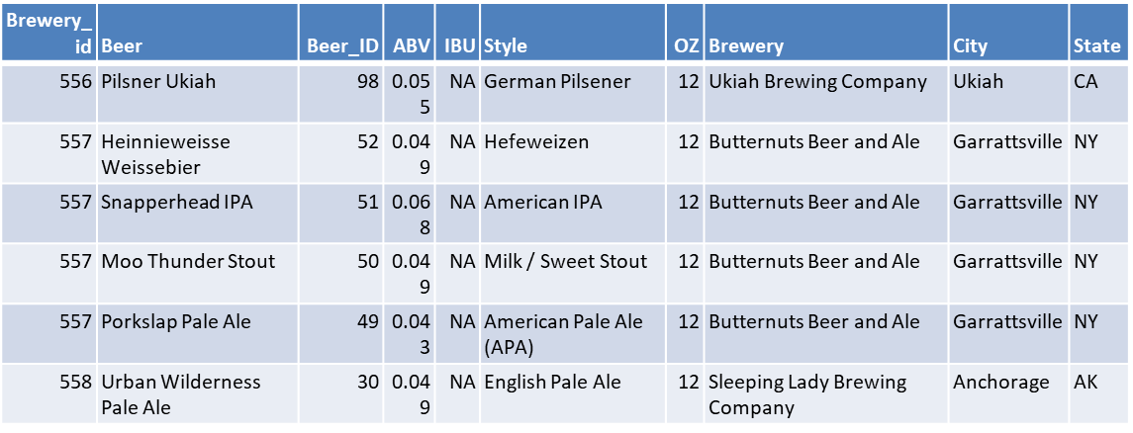
Merge Two Datasets
Brewery_id | Beer | Beer_ID | ABV | IBU | Style | OZ | Brewery | City | State
1 | Get Together | 2692 | 0.045 | 50 | American IPA | 16 | NorthGate Brewing | Minneapolis | MN
1 | Maggie’s Leap | 2691 | 0.049 | 26 | Milk / Sweet Stout | 16 | NorthGate Brewing | Minneapolis | MN
1 | Wall’s End | 2690 | 0.048 | 19 | English Brown Ale | 16 | NorthGate Brewing | Minneapolis | MN
1 | Pumpion | 2689 | 0.060 | 38 | Pumpkin Ale | 16 | NorthGate Brewing | Minneapolis | MN
1 | Stronghold | 2688 | 0.060 | 25 | American Porter | 16 | NorthGate Brewing | Minneapolis | MN
1 | Parapet ESB | 2687 | 0.056 | 47 | Extra Special / Strong Bitter (ESB) | 16 | NorthGate Brewing | Minneapolis | MN

Slide 9
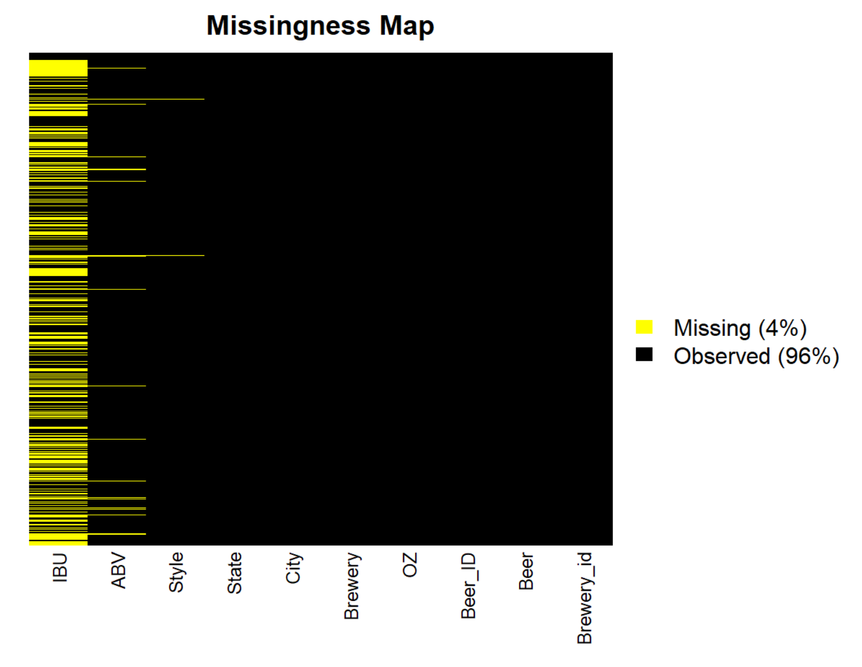
Missing Data
 | MissingValues
Brewery_id | 0
Beer | 0
Beer_ID | 0
ABV | 62
IBU | 1005
Style | 5
OZ | 0
Brewery | 0
City | 0
State | 0

Slide 10
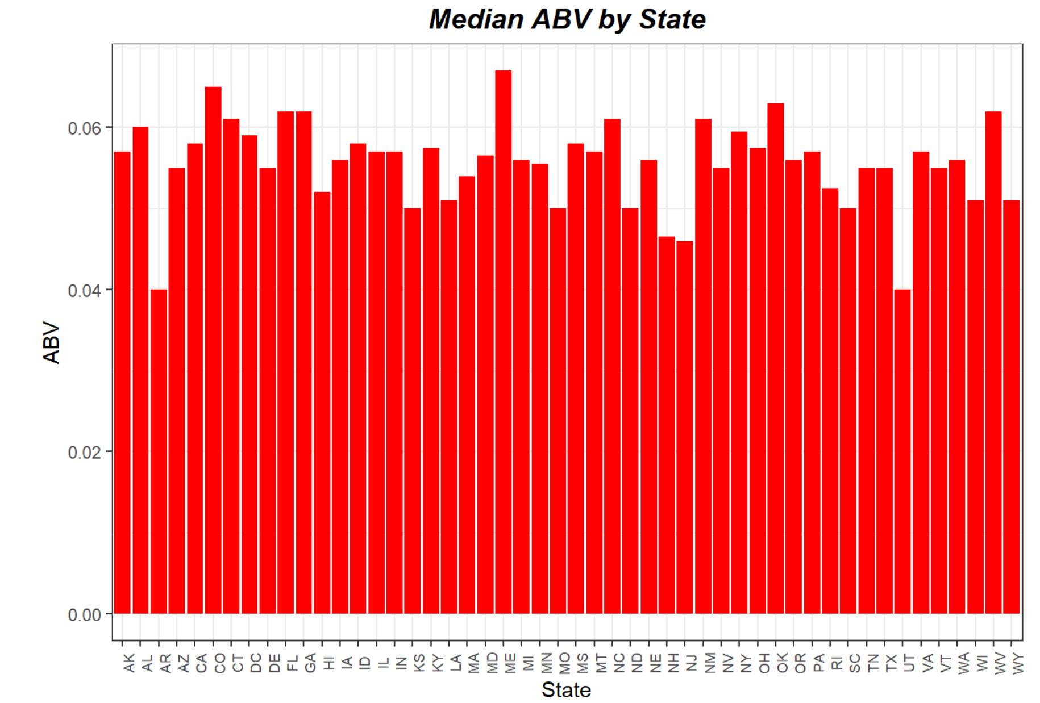
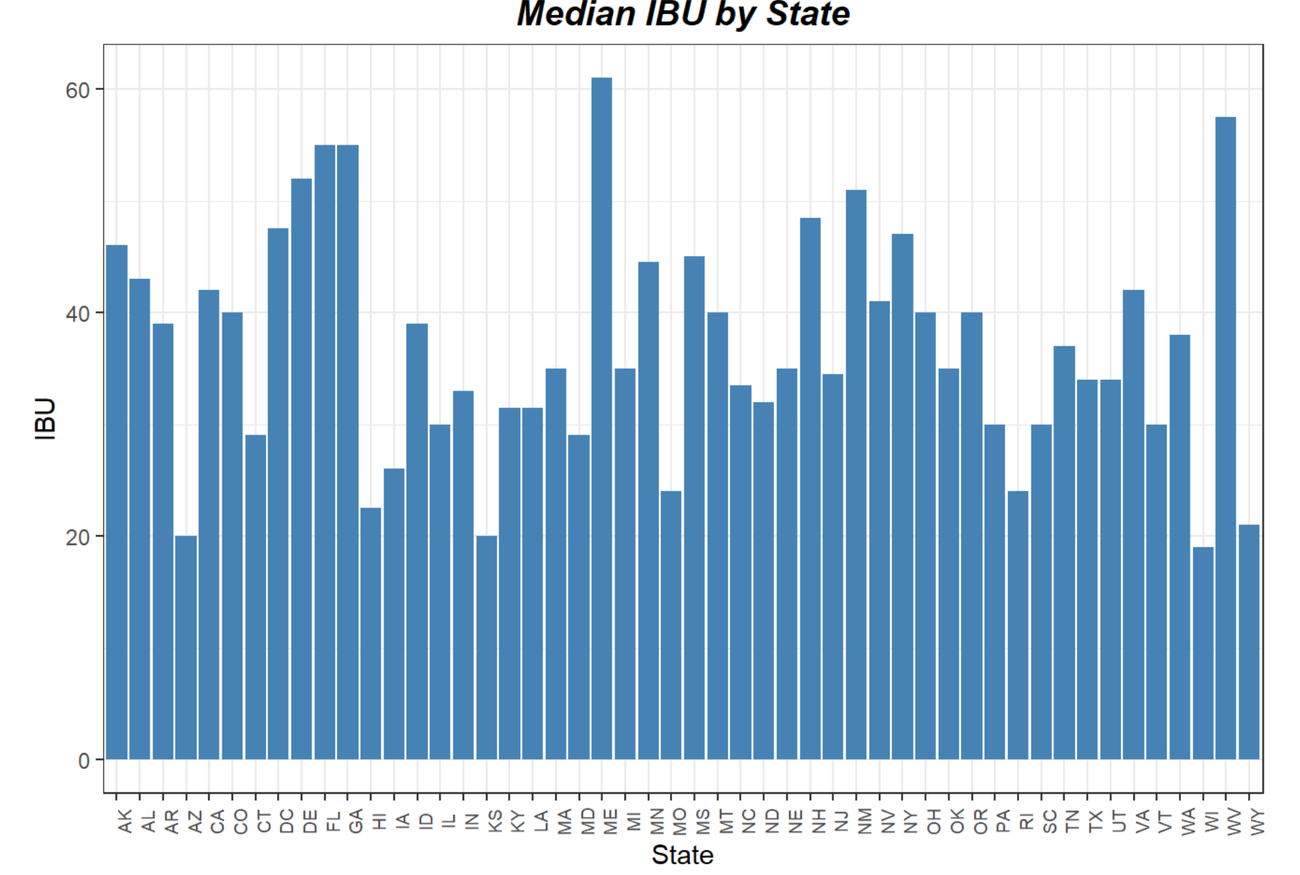
Plot of Median ABV and IBU by State

Slide 11
Maximum ABV and IBU
Which state has the maximum alcoholic (ABV) beer?
Colorado 0.128
Which state has the most bitter (IBU) beer?
Oregon 138

Slide 12
Summary statistics for the ABV
Min | 1st Qu | Median | Mean | 3rd Qu | Max | NA’s
0.001 | 0.05 | 0.056 | 0.05977 | 0.067 | 0.128 | 62

Slide 13
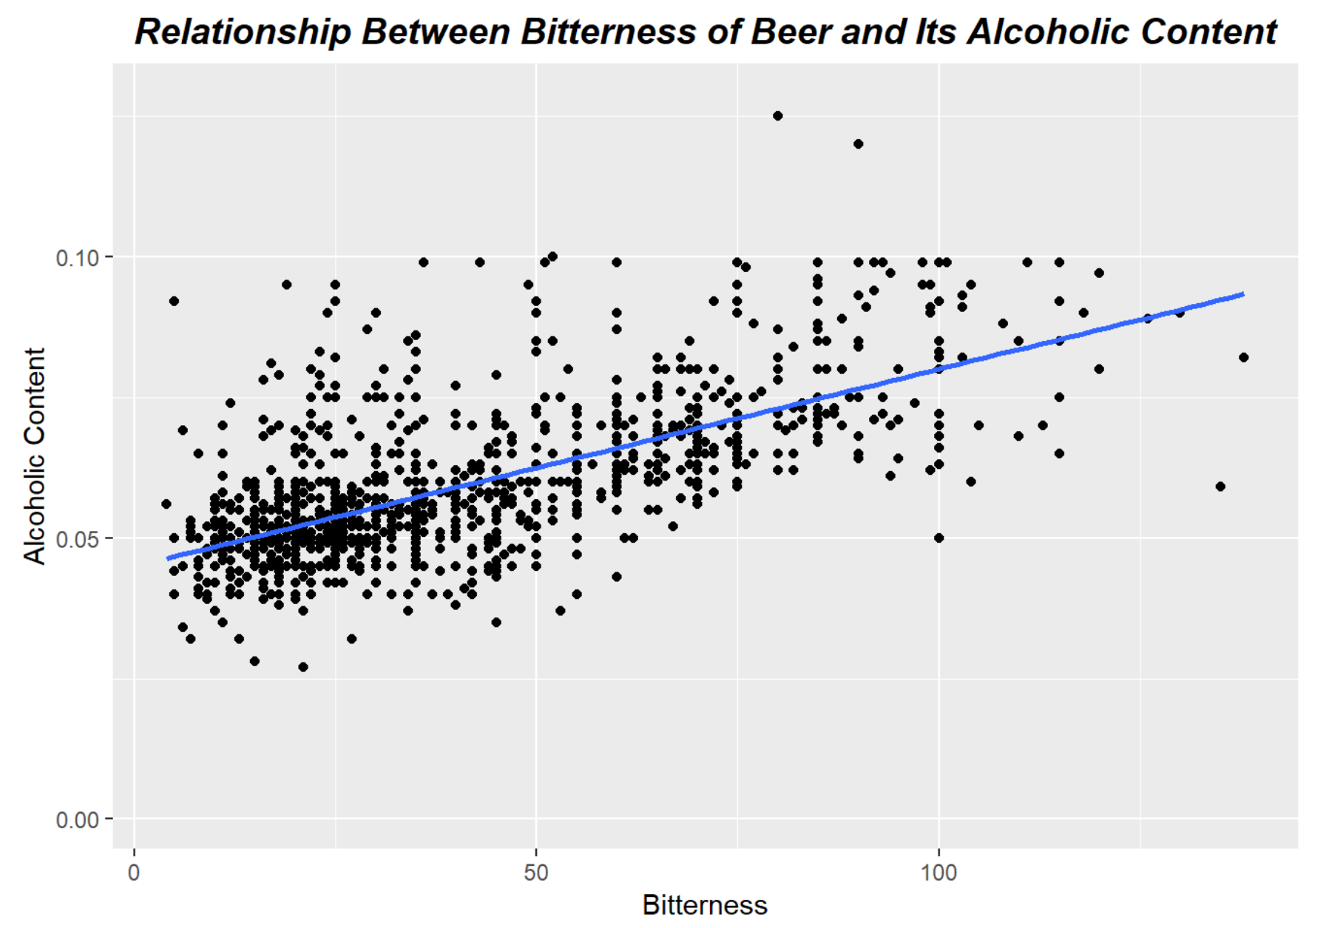
Bitterness and Alcoholic Content Relationship

Slide 14
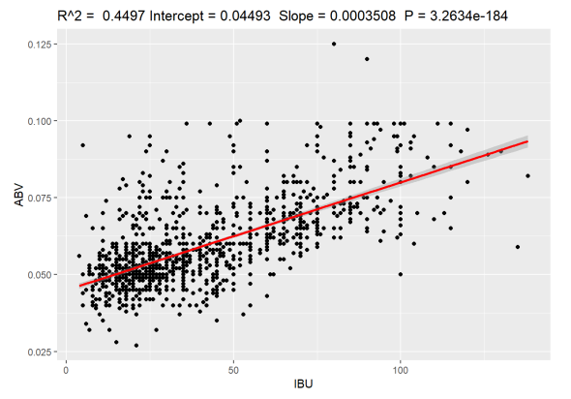
Modeling Bitterness and Alcoholic Content Relationship
ABV= 0.04493 + 0.0003508(IBU)

Slide 15
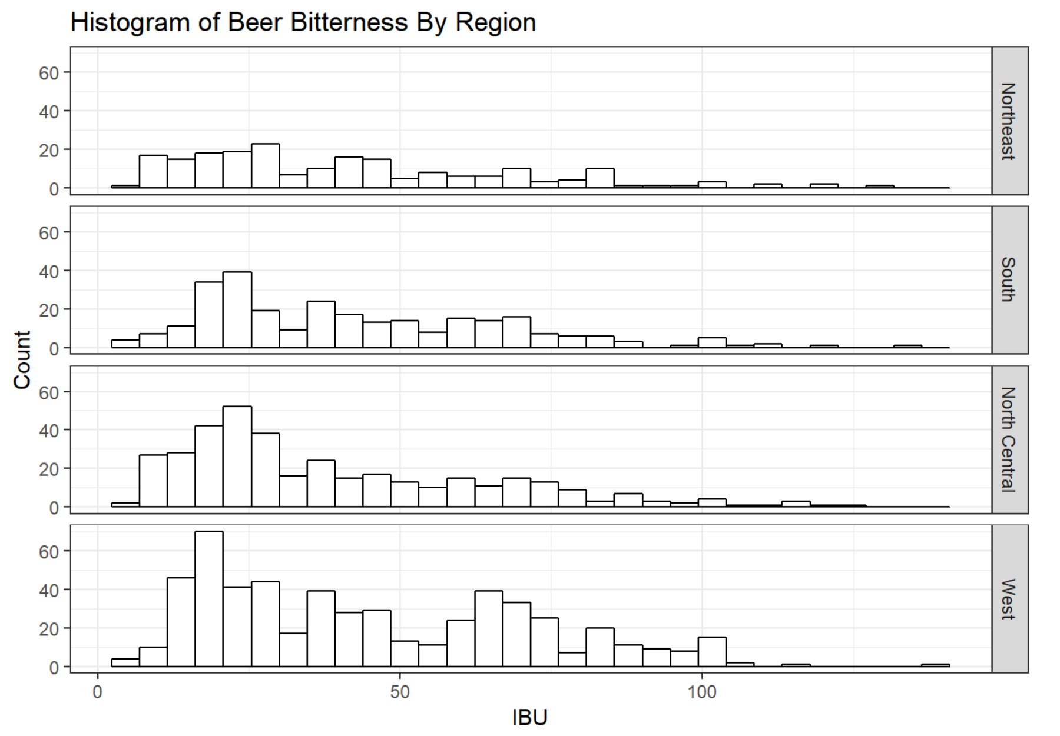
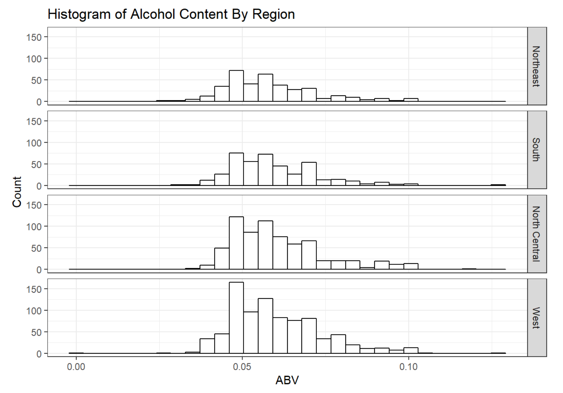
ABV and IBU Histogram per Region

Slide 16
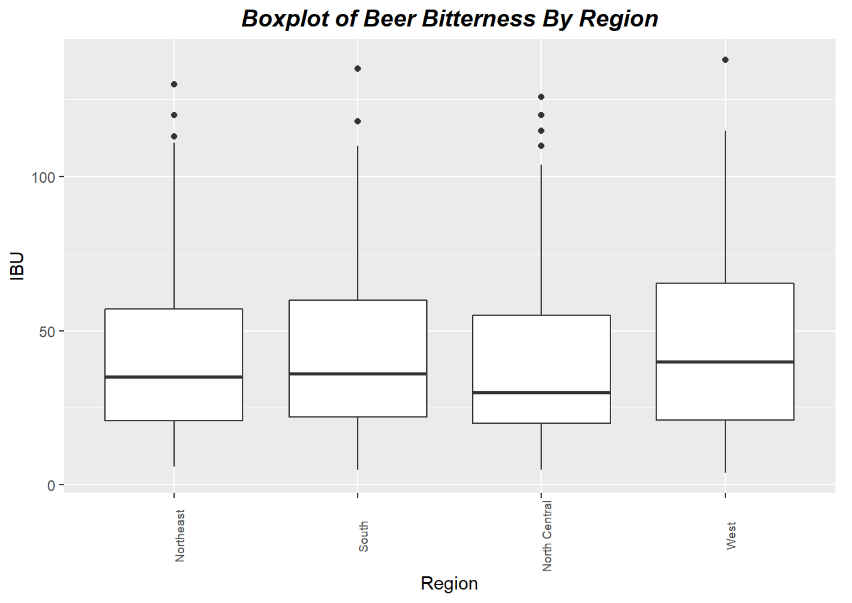
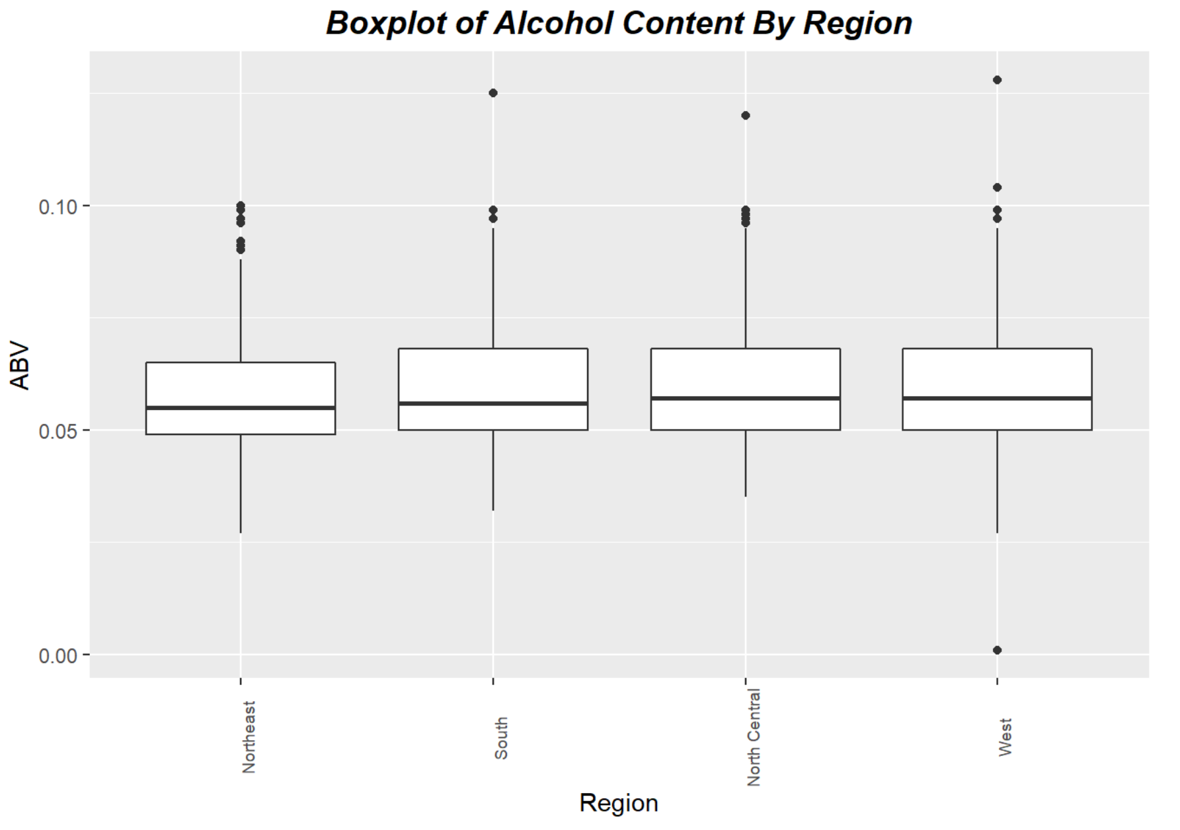
ABV and IBU Boxplot for Region

Slide 17

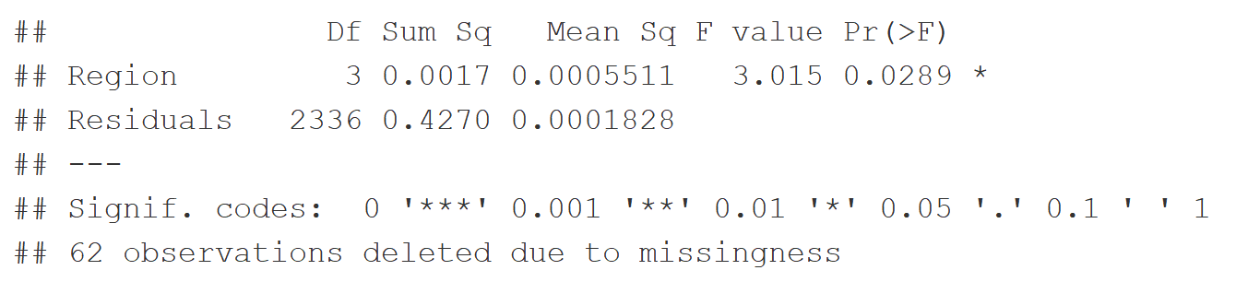
Analysis of variance for ABV
Comparing the p-value of 0.0289 to a confidence level of 0.05, we can conclude that the ABV differs in each region. Using the Bonferroni Multiple Comparison Procedure, we find specifically that the ABV differs in the North Central and Northeastern regions.

Slide 18
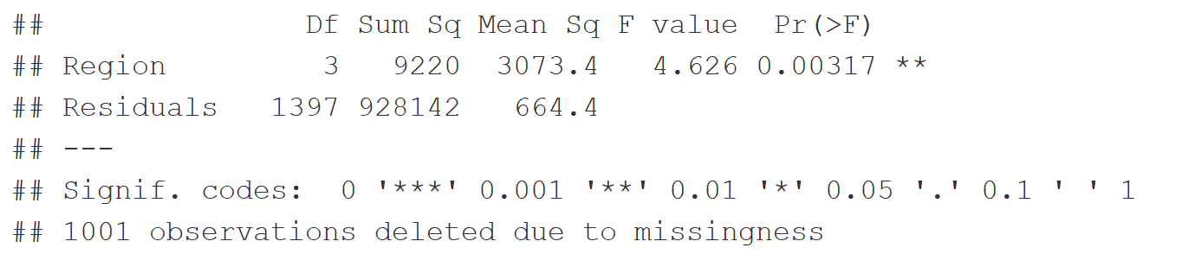
Analysis of variance for IBU
Comparing the p-value of 0.00317 to a confidence level of 0.05, we can conclude that the IBU differs in each region. Using the Bonferroni Multiple Comparison Procedure, we find specifically that the IBU differs in the West and North Central regions.

Slide 19
Conclusion
Relationship between the International Bitterness Unit (IBU) and Alcohol Content by Volume (ABV)
Boost sales by catering to the preferences of those who drink Budweiser

Slide 20
Q&A

